Slide 1
Hacking Your Career Through Social Engineering
Rebecca Long | @amaya30
Future Ada | @futureada
#DEFCON27 | #SEVillage

Slide 2

Let’s Get Started…
Rebecca Long | @amaya30 | #DEFCON27 | #SEVillage

Slide 3
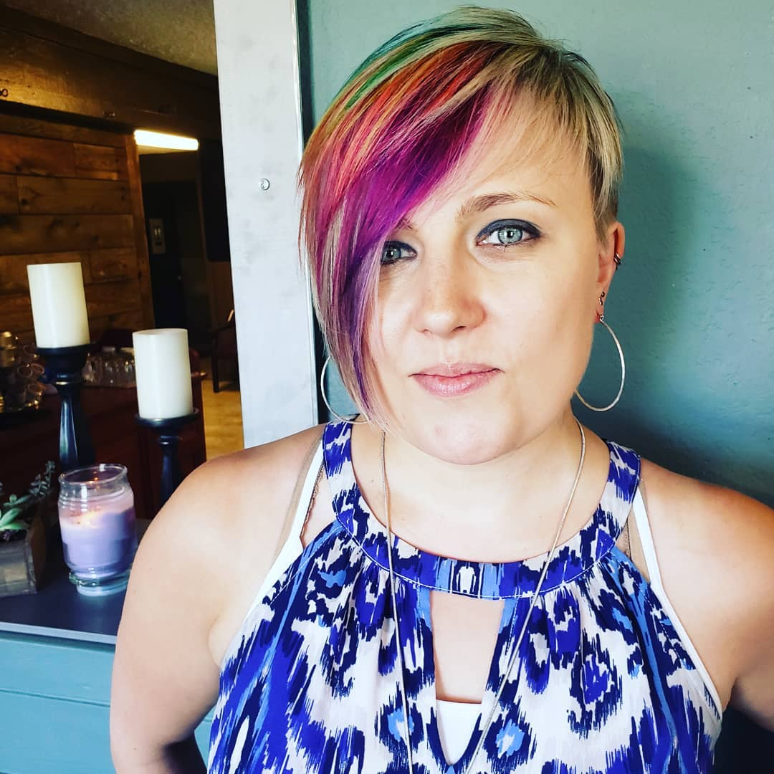

Who is this person?
Computer science background
Master’s thesis on social engineering & phishing
15 years in tech in QA & DevOps
Lead DevOps Engineer at RiskLens
President & Founder of non-profit Future Ada
Advocate for diversity & inclusion in STEAM (science, tech, engineering, art, & math)

Slide 4
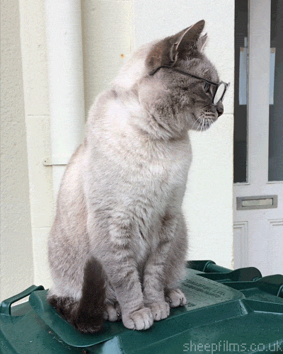
Contact me
Rebecca Long
@amaya30
rebecca@futureada.org
https://rebeccalong.tech
Future Ada
@futureada
hello@futureada.org
https://futureada.org

Slide 5

Why is this important?
Using these skills is helpful…
to minorities
for introverts
for any industry
for all people
Notes:
This is important because many folks can use these skills to combat internal and external hurdles in career advancement. Minorities have extra challenges in many tech careers. Introverts also have some hurdles to overcome depending on their career ambitions. But really these skills can be applied not just to tech and cyber security jobs, but to any job in any industry. Anyone can benefit from learning some social engineering to help them in work and in life.

Slide 6

What’s our goal here?
See how social engineering skills can be used ethically to positively impact…
your work
your career
your company
the industry!
Let’s use our powers for good!
Rebecca Long | @amaya30 | #DEFCON27 | #SEVillage

Slide 7

A Few Reminders…

Slide 8

Social Engineering Key Skills
Emotional Intelligence
Nonverbal Communication
Body language
Tone
Understanding people!
Rebecca Long | @amaya30 | #DEFCON27 | #SEVillage

Slide 9
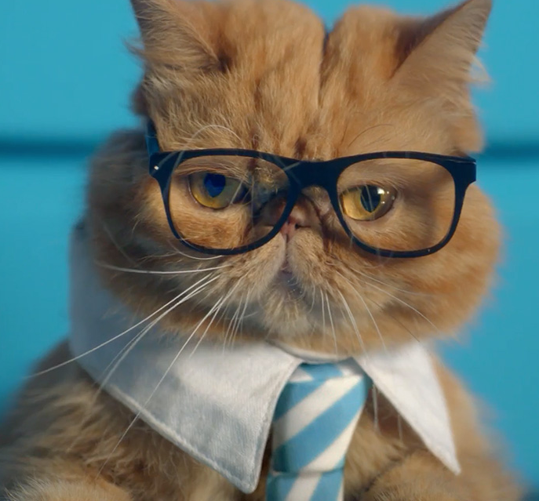
Career Applications!

Slide 10
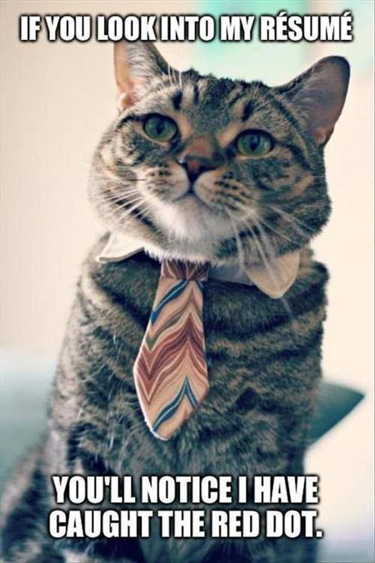
Job Hunting

Slide 11
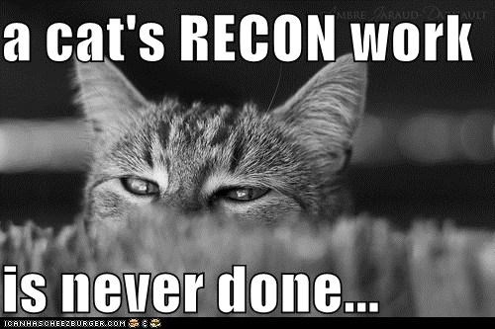
Getting the Job
Recon is key
Who is this company?
What do they stand for?
Who is the hiring manager / team?
What do others you trust say about this company?
Notes:
Do your research for any company you are looking to apply at. Who are they? What do they stand for? Do they have a many diverse folks working for them? What do they say about working there? Is there HR or no? What are they doing in the community to show they care about the industry as a whole and the diverse members we have?
Who is the hiring manager? Do you know them? Do you know anyone who does know them? See if someone can put in a good word for you with them. Learn what they like… are they more casual with interviews or more formal? This is extra helpful when deciding how to dress when you show up to interview in person or via video.
Does anyone you know and trust recommend this company? I have a personal black list of companies I wouldn’t work for cause they aren’t recommended from trusted individual or because I’ve had my own experiences to warrant not wanting to join their team. Everyone should have a list like this. Network to find out what you can about where you are looking at getting a job then make your own decision based on all the information.

Slide 12
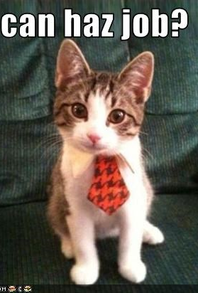
Interviewing
More recon!
how formal of an outfit do you need?
have good questions ready to ask about the company, the team and the job
Connect with everyone in the interview – build rapport quickly
Read the room
Be appreciative of everyone’s time
Notes:
As already stated, find out what is preferred with this company and hiring manager on formality with interviewing. Generally shorts aren’t acceptable, but good to find out if a full suit is needed or just a nice button up shirt with jeans.
Do more research to gather good questions to ask in your interview. People LOVE talking about themselves and their work. Find out as much as you can ahead of time to ask questions to get folks talking. When in the interview, pay attention to what is said, how folks dress, and the office décor. See if you can find anything to help get the interview team talking about themselves as individuals or as a team. Maybe “do you all do team building events? What was the best one you’ve had?” Don’t be afraid to share personal tidbits about yourself too as this gives bridges for the interviewers to build this rapport with you as well. How can they know if you can bond over mountain biking if you don’t mention it as a hobby? Maybe you are into chinchillas (vs cats for some reason)… that’s an interesting fact that can help you stand out from the other candidates. And who knows? Maybe someone on your interview panel can relate to this interest! You want to try to build rapport with each interviewer as best as you can.
Read the room and keep an eye on it as you go to try to adapt if an answer isn’t well received. Or if something connects well with the team, play off that and work with the positive response to further that rapport.
Obviously, you want to be appreciative of everyone’s time. Genuinely appreciate folks for taking time out of their day to talk to you. This is time away from productivity and projects. Thank people in person and thank them in a follow up note. Even if they don’t hire you, you got some practice in with interviewing. Thank them.

Slide 13
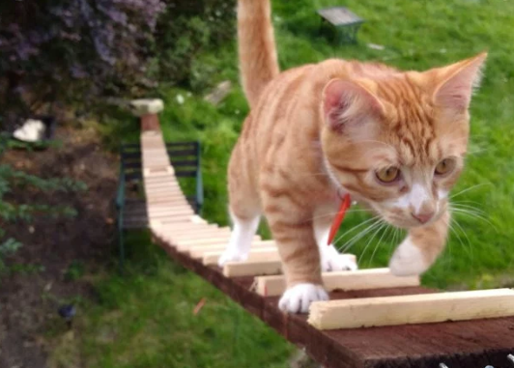
Climbing the Corporate Ladder
Networking is so important!
Internally - get to know the inner workings of your company
Externally - get to know others in industry
Have an elevator pitch
Be authentic and genuine when meeting folks
Notes:
Network within your company. Get to know who is who. Who makes decisions. Who can be trusted and who can’t. What do execs look for when promoting people. What are the top concerns people see within the company and how can you help with those.
Network external to your current company. I’m a big believer in safety nets and an external network within your industry will help provide that if you need a quick (or slow) exit from where you are. Get your name out there. Know who’s who in your community locally and more broadly.
How does your part of tech industry communicate? Twitter is super common and popular but are there other ways? What in person meetings are going on? Go to them. It might make introverts and some others uncomfortable to step outside your comfort zone, but this is so important.
If others know who you are, they will advocate for you and help connect you to future job or volunteer opportunities.
Create and practice your elevator pitch – being able to share who you are and what you do and why you are awesome in the length of an elevator ride.
Ask others who they are, what they do, where they work, what they need, what their concerns are, etc. Get to know them as people too. Do they have families? Do they also love cats? What are their hobbies? Do so and care about their answers. Listen and remember their answers.
These connections might help you in your own job, but they might also help connect someone else to you that might be a good hire. We are all stronger when we work together and care about one another.
When networking, you have be authentic and genuine in your interactions. People can see through it if you aren’t.

Slide 14

Day to Day Success

Slide 15

Conveying Confidence
Battling imposter syndrome
Have a pretext of being confident
Fake it until you make it!
Confident non-verbals
Eye contact / hand shake / posture
Take up space
Power poses
https://www.ted.com/talks/amy_cuddy_your_body_language_shapes_who_you_are/transcript?language=en

Slide 16
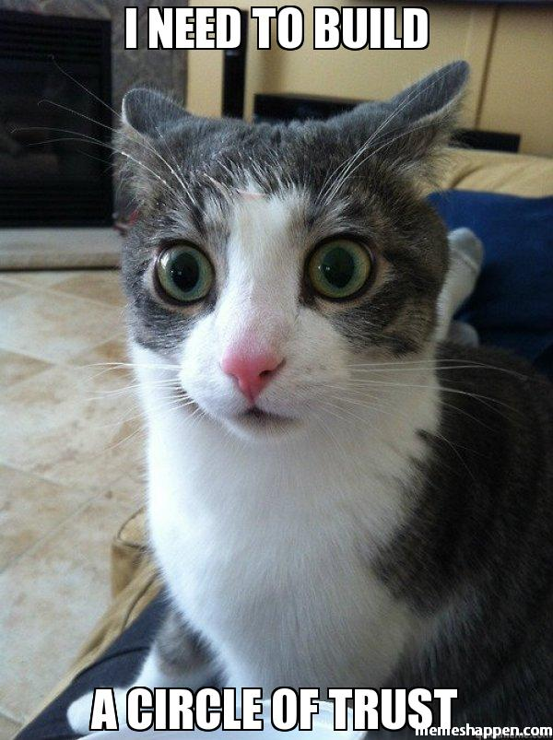
Integrating into a New Company
What message do you want to convey?
Creating rapport with team members
Get to know your new colleagues as people
Build trust and respect
Have empathy & compassion
Notes:
What message do you want to convey? This applies to when you join a new company and really anytime. How you dress and look impacts how we are perceived by others. I will always advocate for being yourself, however, try to find a way to express who you are in a way that you understand the messaging coming across and that you can align on what the consequences of it is. If you have that in alignment then if people don’t accept you that will be easier and probably a mutual feeling. But also recognize that if your look is a dark hood with shades you might not be conveying an approachable feel which could impact connecting with others and growing your career.
Creating rapport with team members by getting to know your new colleagues as people who have lives and hobbies and families. What do they do on their weekends? What are their favorite foods? Where did they grow up? Where do they want to go with their careers?
Build trust and respect with those around you. Getting to know folks as individual people vs just a coworker doing a job will help get you started. Genuinely care about what they share and remember it. Help them out and follow through with your commitments. Some have a pet peeve about being late to meetings? Always show up on time for them. Little things like that can really help.
Have empathy & compassion for those you work with and everyone else. We are all people and have life stuff happen. These can be good life stuff or bad. Big and little. Marriage/divorce or a breakup. Kids and pets can impact your work life. Care about these details and have empathy and compassion for people when they are going through things and give them grace for when it impacts productivity or moods.

Slide 17


Office Politics
Focus on those interpersonal relationships and rapport with folks
Listen to all sides of situations
Use your charm / persuasive powers to fight for what you believe in
Notes:
Again… focus on those interpersonal relationships and rapport with folks
Disputes happen. People are complicated and don’t always get along. Do your best to stay calm through the waves and listen to all sides of the story before making judgements. Ask people directly if you want to know their side vs just using the rumor mill or telephone games. (Personal pet peeve of mine)
Use your charm / persuasive powers to fight for what you believe in. This might be for a project or a decision or more resources. If you think it’s right, push for it within reason (still remember who you work for) and be mindful and accepting of what the consequences might be for your actions. But if it’s what you believe in, it’ll be easier to accept any negative consequences.

Slide 18
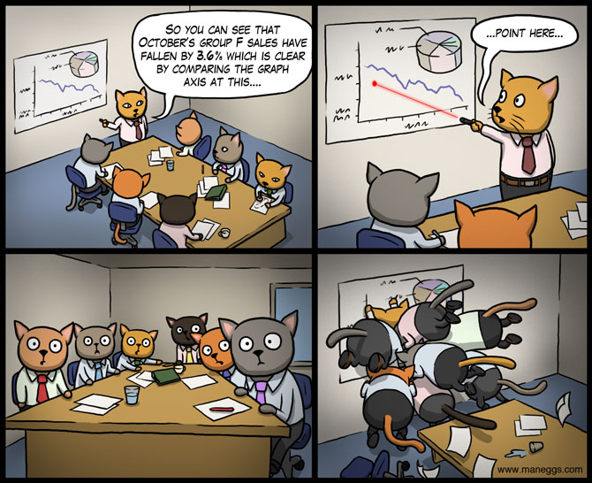
Doing Meetings Right
Structure meetings to maximize impact
Read the room
Who is making decisions?
When are decisions being made?
Are there a lot of post-meetings or closed door meetings?
Notes:
Maximize meetings by learning what your attendees work best with.
Morning meetings preferred? Back to back meetings a pro or con? Might be desired to group meetings to maximize free time during the rest of the day.
Generally having an agenda organized and shared with the group beforehand is helpful to keeping meetings structured and on track. Sharing it early also gives attendees an opportunity to speak to agenda items early or request things be added or removed. Maybe the agenda will spark enough of a conversation the meeting can be canceled!
Know your audience of who’s attending. This can impact your level of formality with how you structure things. If it’s just for you and a team mate to work through a problem, might not need a formal agenda or even a full conference room. Is an exec joining you? Know what they prefer in meetings to be sure you can convey the right message and don’t distract them with thoughts you might be disorganized. Agenda? Handouts? PowerPoint? Being on time for start and finish? Ask around if you don’t know, remember these details and use them to help your cause.
In your meeting, read the room and pay attention to how folks are doing. Are they all engaged? Falling asleep? Has the meeting gone on too long and folks are fading? Maybe it’s time to call it and schedule an official follow up to finish the conversation after a break. Your attendees are people and are subject to human needs like coffee, bathroom breaks and fall prey to exhaustion in many different ways. Pay attention and try to get folks together when they are at their best and then help keep them there.
Notice who is making decisions in your meetings. Do they always get deferred to one or two people? Do decisions and conversations get stifiled if a certain person is in attendance? Maybe have meetings without that person to get in the conversations needed.
If your meetings aren’t getting any decisions, and you just sit and spin your wheels over and over, time is being wasted. Restructure the meeting and the conversation so you can get decisions and actions coming out of your meetings.
Are meetings regularly followed by a lot of post-meetings or closed door meetings? This tells you that there are conversations being had that folks are comfortable with sharing to the group. Or that they are upset and venting to colleagues about the meeting. Both things mean changes are needed so people feel safe and comfortable with being open and honest in the meeting. We can be more efficient in our work if folks trust each other enough to speak up in the group. Work to build more rapport and trust among team members to help start to combat this problem.

Slide 19
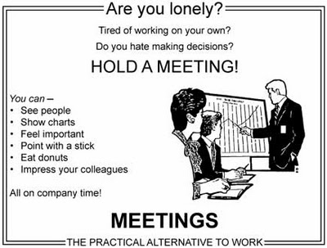
Notes:
This is what you do not want to do. This is not how you want to hold meetings.

Slide 20
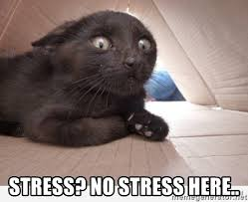
Dealing with Stress
Stress happens
Having strong relationships with coworkers will help you ride through stressful times

Slide 21

Goleman, Daniel
Emotional Intelligence: Why It Can Matter More Than IQ
“The quality of relationships as well as their sheer number seems key to buffering stress.”

Slide 22
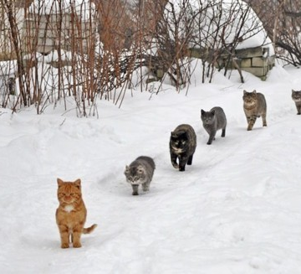
Leadership
Notes:
Let’s talk about leadership. This is not restricted to only management. We are all leaders in our own way and can be leaders on our team.

Slide 23
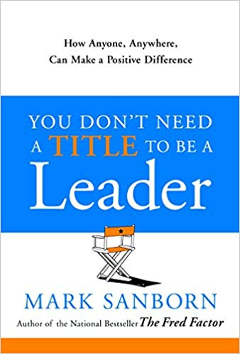
Reminder: Title != Leader
Managers
Leaders
Have employees
React to change
Have good ideas
Communicate
Direct groups
Try to be heroes
Take credit
Exercise power over people
Win followers
Create change
Implement ideas
Persuade
Create teams
Make heroes of others
Take responsibility
Exercise power with people

Slide 24
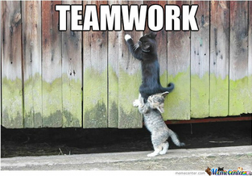
Build a Strong Team Culture
Notes:
Team cultures will be unique to each team of course. But the strong ones will all have similar key traits: trust, empathy, compassion.

Slide 25
Ari Pinkus A Call for More Inclusive, Empathetic Leadership
“Higher emotional quotients have greater sensitivity and empathy, are rated as more effective, receive higher performance ratings, develop high-performing effective teams, and create a healthier … culture”
https://www.nais.org/learn/independent-ideas/november-2016/a-call-for-more-inclusive,-empathetic-leadership/

Slide 26
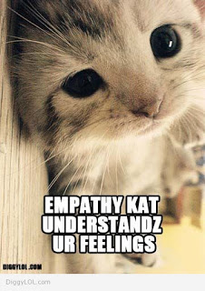
Empathetic Leadership
Remember we are all people with lives, families, hobbies, passions, and emotions
Get to know team members as people
Create a safe space for people to bring their full selves to work
Recognize the emotional impact on employees / coworkers when major life events happen
Births / Deaths
Marriage / Divorce
Notes:
Again, remember we are all people with lives, hobbies, and all those messy emotions.
As a leader we need to take time to get to know our employees as well as our peers. We have humans reporting to us. Take time to know them as people.
Create a safe space for them to bring their full selves to work. This will allow them to flourish and be their best, productive, happy self. Everyone wins when we allow people to be who they are at work without judgement.
You can do this through things like inclusive language, empathy, and compassion.
I mentioned it before and will mention it again. Life happens. Have empathy for those who have big life events going on and provide some grace for the impact that might be having on their work.

Slide 27
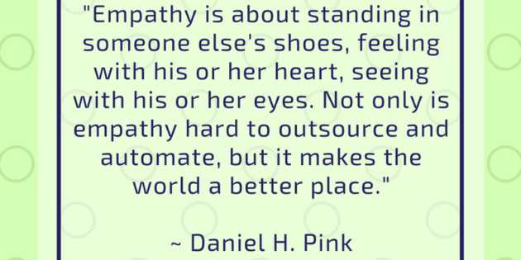
Notes:
In case anyone needs a description of what “empathy” is here is a great quote from Daniel Pink.

Slide 28
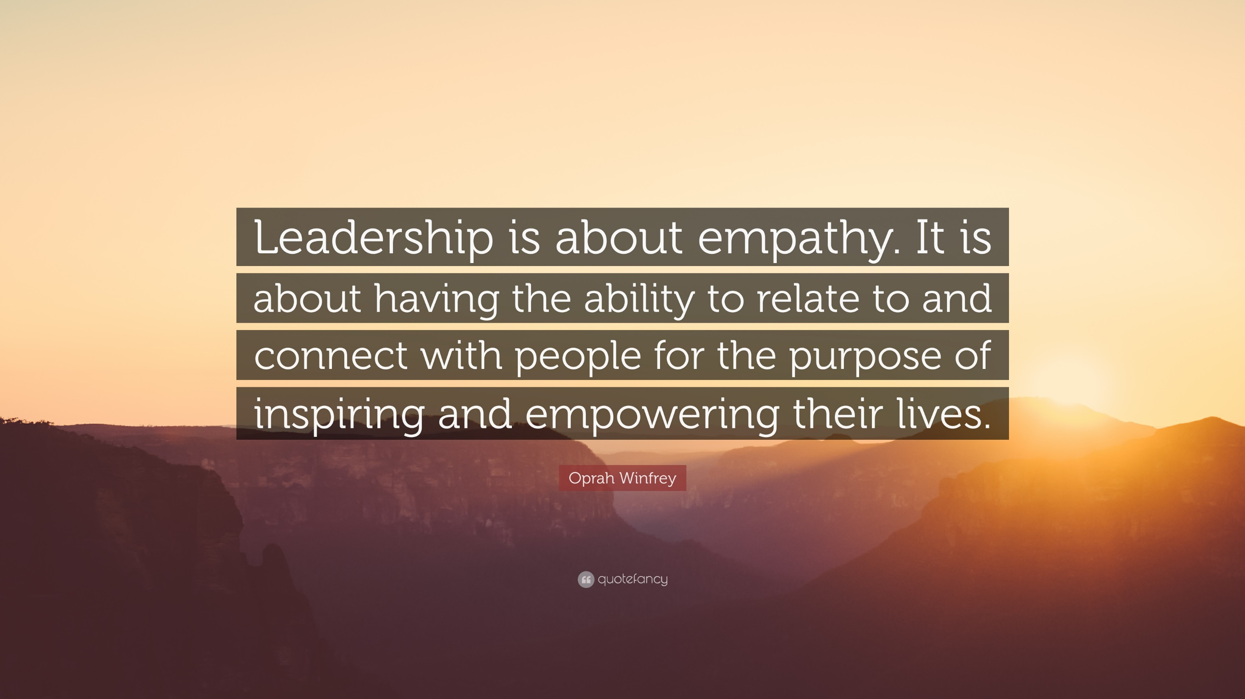
Notes:
Using our powers for good!

Slide 29

Supporting Your Team Members
Ask coworkers about their weekends, families, hobbies, etc.
Remember things they tell you!
Care about folks at every level in your company / team
Titles != Level of Importance
We all play a part in team success
Notes:
Ask coworkers about their weekends, families, hobbies, etc.
Remember things they tell you! Birthdays, big life events, stories, etc.
Care about folks at every level in your company / team.
Don’t rank importance based on job title
Admin assistants and non-technical roles are just as important as any Info Sec or other tech role
We all play a part in team success!

Slide 30
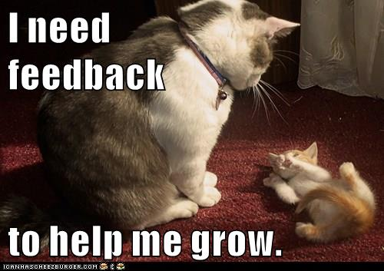
Creating Positive Feedback Loops
Create feedback loops
Encourage feedback be shared in constructive ways among team members
Create a safe space for folks to give you feedback
Lead by example
Don’t forget to give lots of positive feedback!

Slide 31

Wrap Up…

Slide 32
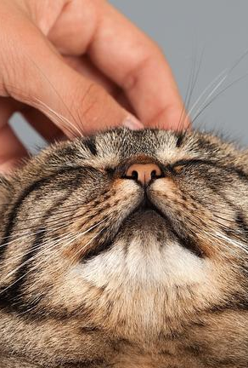
It’s all about the people
Social engineering is about using people skills
Cyber security is all about people
securing people, securing people’s data
We can take these skills and help our careers via ethical & positive applications
We can use these skills to help our teams, our companies, our projects and the industry
Use our powers for good!

Slide 33
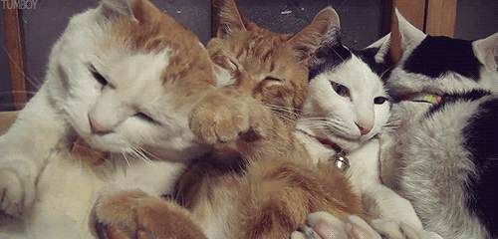
We are stronger when we care about those we work with

Slide 34
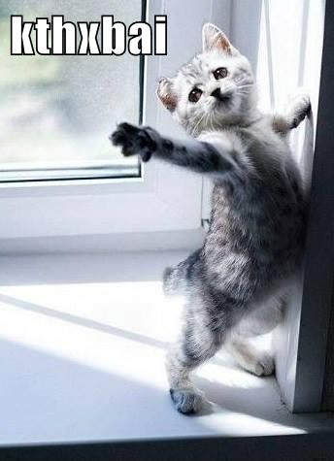
Thanks!
Rebecca Long
@amaya30
rebecca@futureada.org
https://rebeccalong.tech
Future Ada
@futureada
hello@futureada.org
https://futureada.org
Notes:
Thank you! Feel free to connect with me. Will take questions after.

